Slide 1
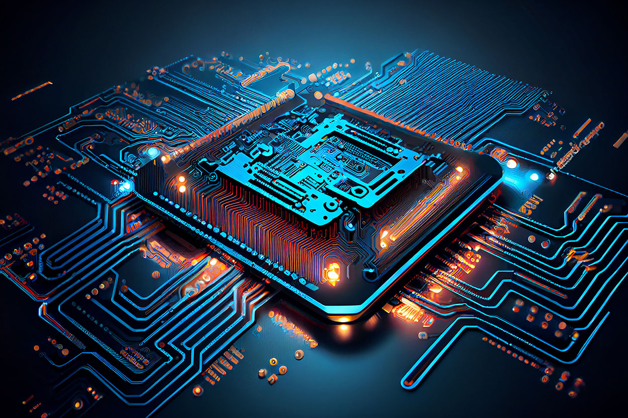
QUANTUM COMPUTING
V.Praveen
22071A67C5

Slide 2
QUANTUM COMPUTING
Quantum computing is a groundbreaking form of computing that uses quantum bits, or qubits, to process information.
Unlike classical bits, which can be either 0 or 1, qubits can exist in both states simultaneously due to superposition, allowing for parallel processing of information.
Additionally, qubits can be entangled, meaning the state of one can instantaneously affect another, regardless of distance.
These unique properties enable quantum computers to tackle complex problems more efficiently than classical computers, revolutionizing various fields.

Slide 3
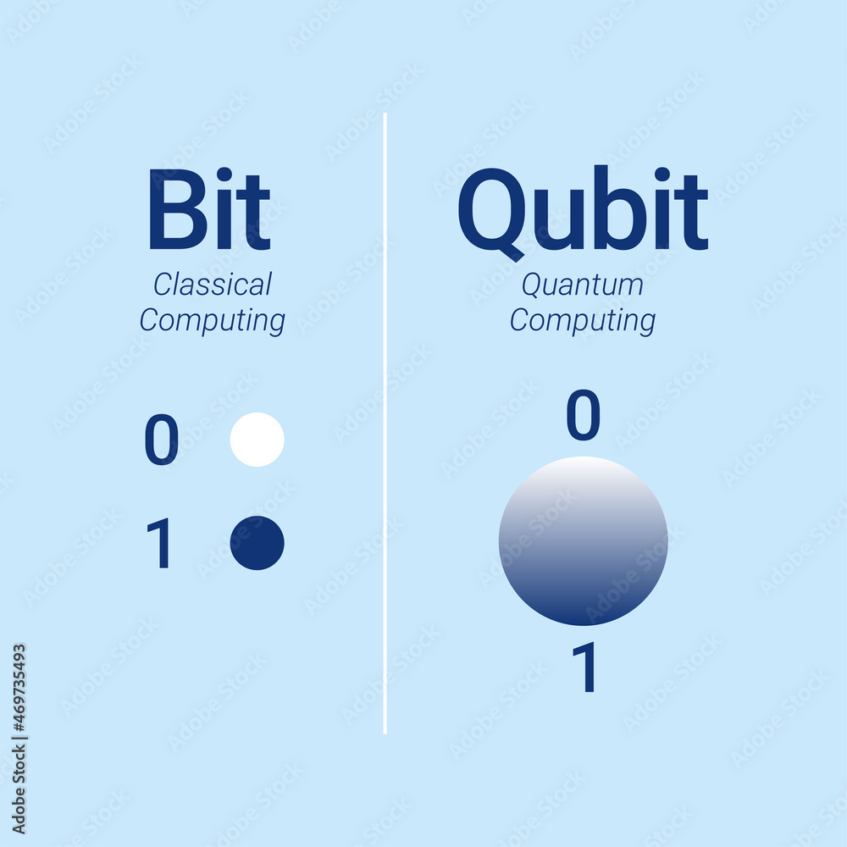
CLASSICAL VS. QUANTUM BITS
Classical Bits: In classical computing, information is stored in bits, which can be either 0 or 1. Each bit can represent only one of these states at any given time, forming the foundation of traditional binary computing.
Qubits: In quantum computing, qubits are the basic unit of information. Unlike classical bits, qubits can exist as 0, 1, or both at the same time due to the quantum phenomenon of superposition. This allows quantum computers to process multiple possibilities simultaneously, providing exponentially greater computational power for certain tasks.

Slide 4
KEY PRINCIPLES
The key principles of quantum computing revolve around three core concepts: superposition, entanglement, and interference.
Superposition allows qubits to exist in multiple states (0 and 1) at the same time, unlike classical bits that can only be 0 or 1. This enables quantum computers to perform many calculations simultaneously, dramatically increasing computational efficiency for certain tasks.
Entanglement is a phenomenon where qubits become interdependent, meaning the state of one qubit directly affects the state of another, even if they are separated by large distances. This interconnectedness allows for faster and more complex data processing.
Interference is like adjusting the odds. It helps increase the chances of finding the right answer and decreases the chances of getting the wrong ones, making the process more efficient and accurate.

Slide 5
QUANTUM GATES AND CIRCUITS
Quantum gates are the fundamental building blocks of quantum circuits, similar to how classical logic gates (like AND, OR, and NOT) are used in classical computers. These gates manipulate qubits to perform specific operations and are essential for running quantum algorithms.
Examples of Quantum Gates:
Pauli-X Gate: Similar to the classical NOT gate, it flips the state of a qubit from 0 to 1 or 1 to 0.
Hadamard Gate (H Gate): Puts a qubit into a superposition, allowing it to exist in both 0 and 1 states simultaneously.
CNOT Gate (Controlled NOT): Entangles two qubits, flipping the second qubit if the first is 1, which enables complex interactions between qubits.
Toffoli Gate: A three-qubit gate that flips the third qubit if the first two qubits are both in state 1. It’s used for error correction and building more complex circuits.

Slide 6
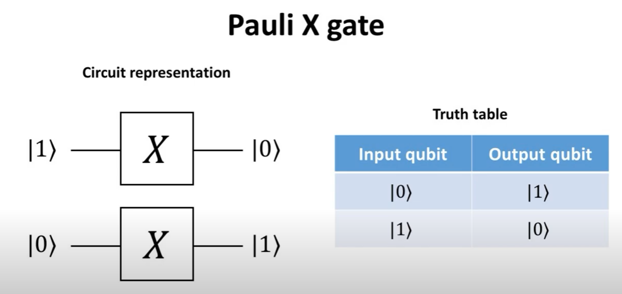
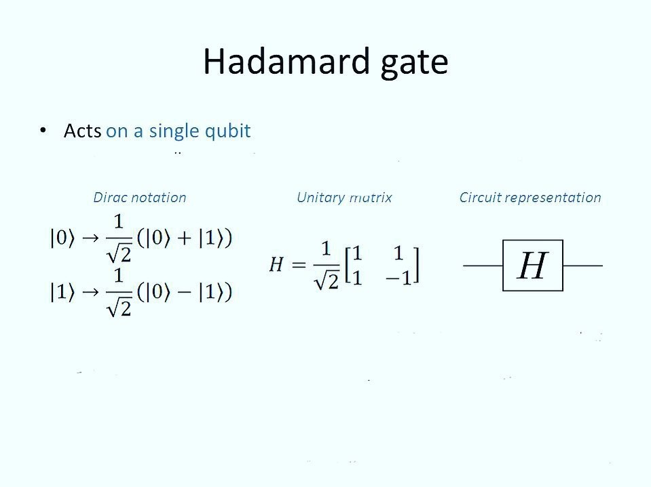
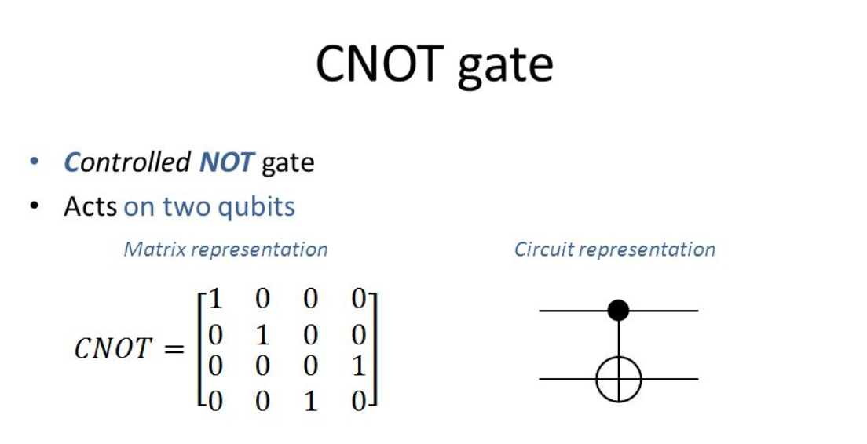
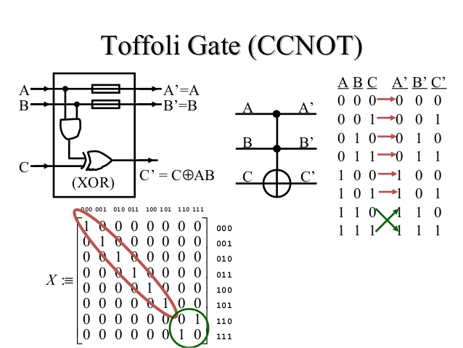

Slide 7
ALGORITHMS
Shor's Algorithm: This algorithm is used to break down large numbers into their prime factors, which is important for online security. Classical computers are very slow at this, but Shor's algorithm can do it much faster, potentially making current encryption methods insecure.
Grover's Algorithm: Grover’s algorithm helps find something in a large, unsorted database much faster than a classical computer. If a normal search takes 100 steps, Grover's algorithm could do it in just 10 steps, making it a lot quicker.
Comparison to Classical Algorithms: Classical algorithms are slower at solving certain problems, like factoring big numbers or searching databases. Quantum algorithms, like Shor's and Grover's, speed up these tasks, making them much more efficient than what classical computers can currently achieve.

Slide 8
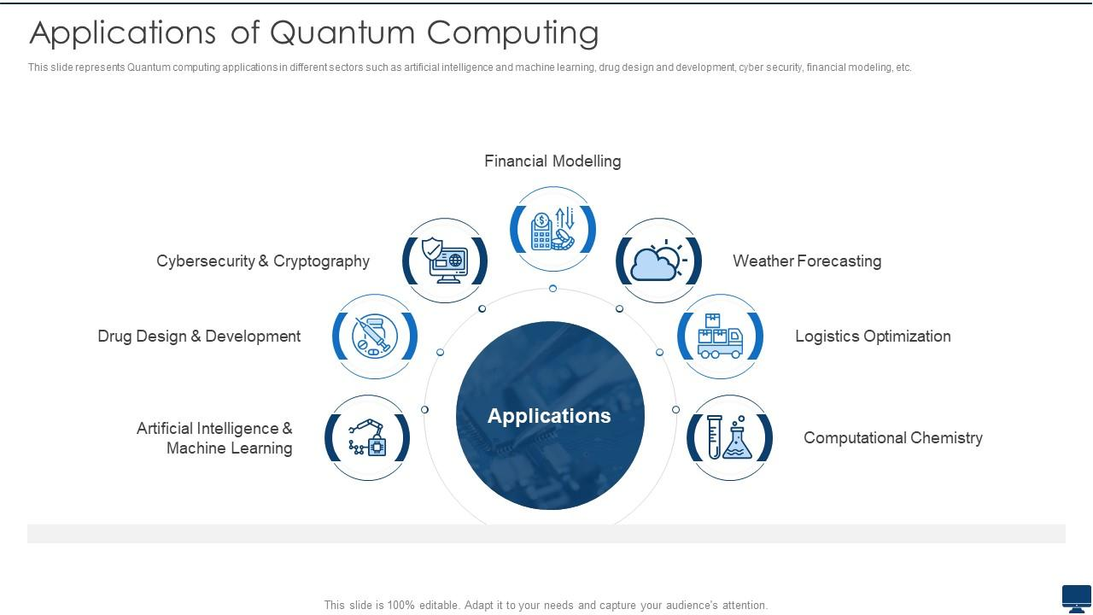
APPLICATIONS
Cryptography: Quantum computers can break the security systems used in online banking and communications much faster than regular computers. This could change how we protect our data.
Drug Discovery: Quantum computers can simulate how molecules interact in great detail, helping scientists discover new medicines more quickly. This allows for testing drug effects without lengthy lab experiments.
Optimization Problems: Quantum computers can efficiently solve complex problems, such as optimizing delivery routes and financial investments, helping industries operate faster and better.

Slide 9
CURRENT STATE
Major Players: Key companies in quantum computing include Google, IBM, D-Wave, and Rigetti. They are all trying to create powerful quantum computers using different methods.
Technological Advancements: There have been important recent developments, including claims of quantum supremacy, where a quantum computer has completed a task much faster than the best classical computers can. For example, Google reported that its quantum computer solved a problem in minutes that would take classical computers thousands of years.
Challenges:
Decoherence: This occurs when qubits lose their information due to interference from their environment.
Error Rates: Qubits often make mistakes during calculations, leading to incorrect results.
Scalability: Building large and stable quantum systems with enough qubits to solve real-world problems is difficult.

Slide 10
FUTURE OF QUANTUM COMPUTING
Potential Developments: In the future, we might see the creation of quantum networks and a quantum internet. This would allow quantum computers to communicate with each other securely and share information, leading to exciting new possibilities for safe communication and collaboration.
Impact on Industries: Quantum computing could change many industries such as Finance, Healthcare and Materials Science.
Public Perception and Education: As quantum technology grows, it’s important for people to understand it better. There will be a need for education and training so that workers can effectively use quantum technologies and contribute to its development.

Slide 11
CONCLUSION
In summary, quantum computing is an exciting new technology that uses the principles of quantum mechanics to perform calculations much faster than traditional computers.
With its ability to process vast amounts of data through qubits, quantum computing promises transformative applications in various fields, including cryptography, healthcare, finance, and materials science.
While quantum computing offers great possibilities, there are still challenges to overcome, such as errors and building larger systems.
The future of quantum computing is bright, but it requires continuous learning, research, and public awareness to fully realize its capabilities. Engaging with this cutting-edge technology will empower individuals and organizations to adapt and thrive in an increasingly quantum world.

Slide 12


